Slide 1
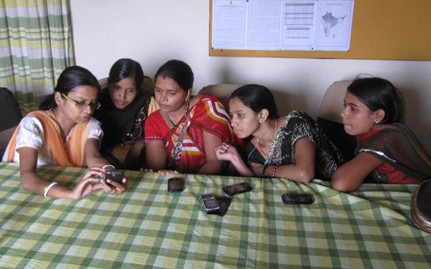
Computing and Global Health
Winter 2015
Richard Anderson

Slide 2
Today: Course Overview
What is computing and global health?
Course organization and HW 1
Background
  Computing
  Global health challenges
  Health systems
  Stakeholders
  Millennium Development goals
  Infrastructure
Topics

Slide 3
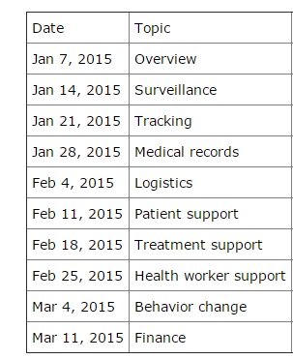
Course organization
Course organized by functional domain
  Other options
    By technology
    By health domain

Slide 4
Course mechanics
Weekly lectures
Weekly reading
Additional optional readings
Weekly assignments
  Usually written
  Submit word / PDF by email or other means
Two multi-week lab assignments to learn about important tools
  DHIS2 (dhis2.org)
  ODK (opendatakit.org)
You will be able to miss a couple of assignments
  Course grade based on top 7 assignment scores out of 9.
No term project
No final exams
http://courses.cs.washington.edu/courses/csep590b/15wi/

Slide 5
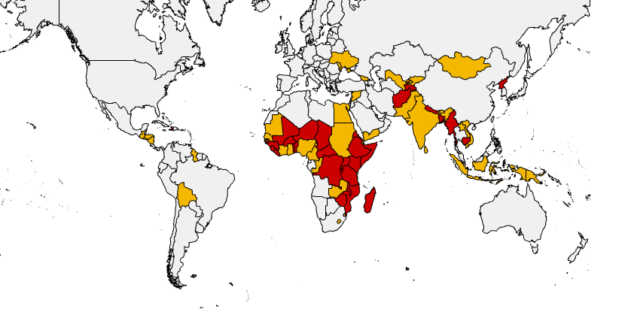
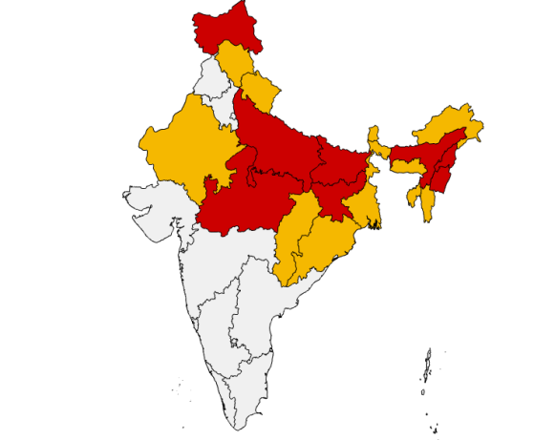
Assignment 1a
Pick three countries to become an ‘expert’ on
  Assignments will often require specializing questions to countries, so pick countries in advance so you acquire background
  Choose LICs (Low income countries) or LMICs (Low-middle income countries) but not UMICs or HICs
  If you want to work with India, choose a low income state of India

Slide 6
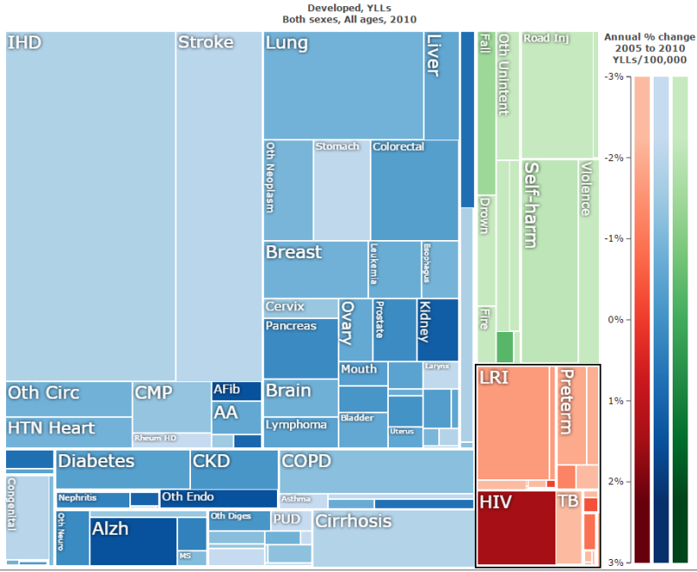
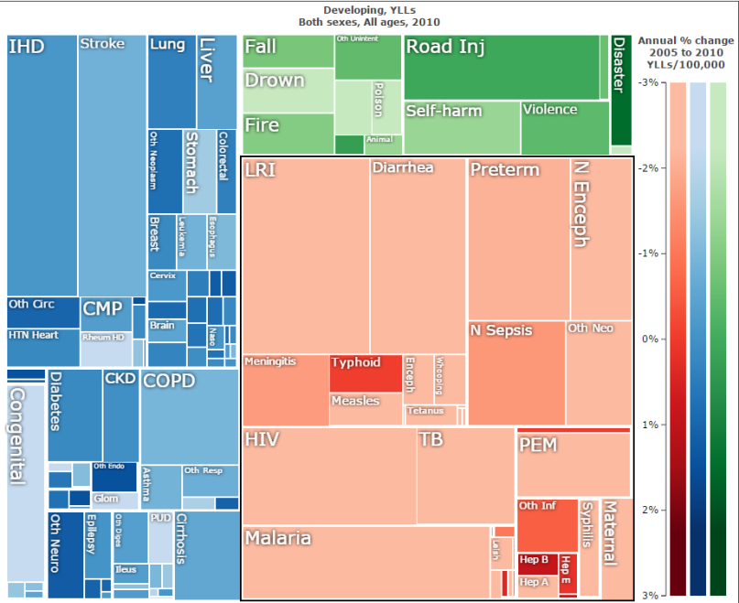
Assignment 1b
Write a summary of the health challenges of your three countries. Use IHME’s GBD visualization tool as a data source.
  http://www.healthdata.org/results/data-visualizations

Slide 7
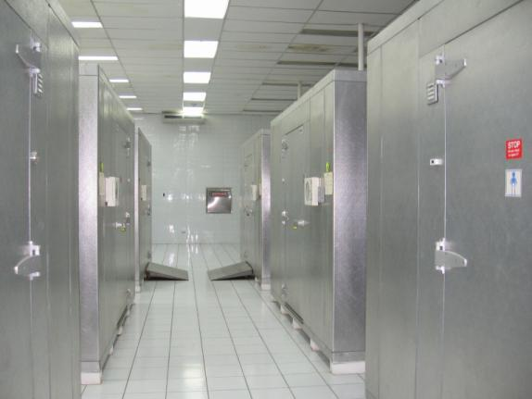
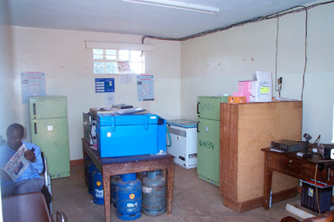
Assignment 1c
For one of your three countries, design a national system for monitoring the countries vaccine cold chain equipment
The system should capture information about whether or not vaccine refrigerators are working so that the indicator “percentage of time facilities have working refrigerators” can be computed
Document challenges and trade offs in implementation of this system

Slide 8
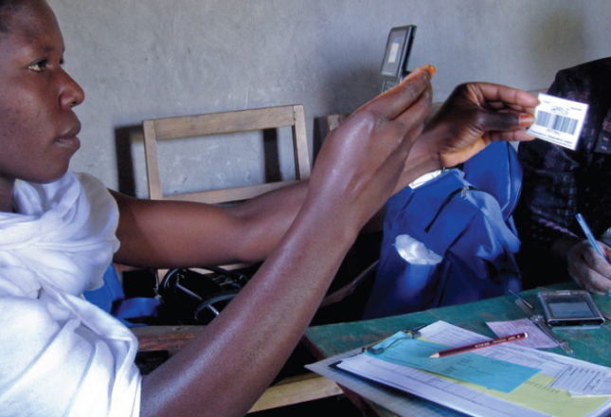
What is
‘Computing and Global Health’?
Study of the use of Information and Communications Technology (ICT) to improve health care and health systems in developing countries

Slide 9
Global health challenges
Burden of disease
  Infant / Maternal mortality rates
  Infectious diseases
Weak health systems
  Limited health infrastructure
  Few doctors
Poverty

Slide 10
The opportunity
How eHealth can support improving global health?
Information and Communication Technology has changed everything else, why not global health?
Information and Communication Technology is required for or enables specific interventions which strengthen health systems

Slide 11
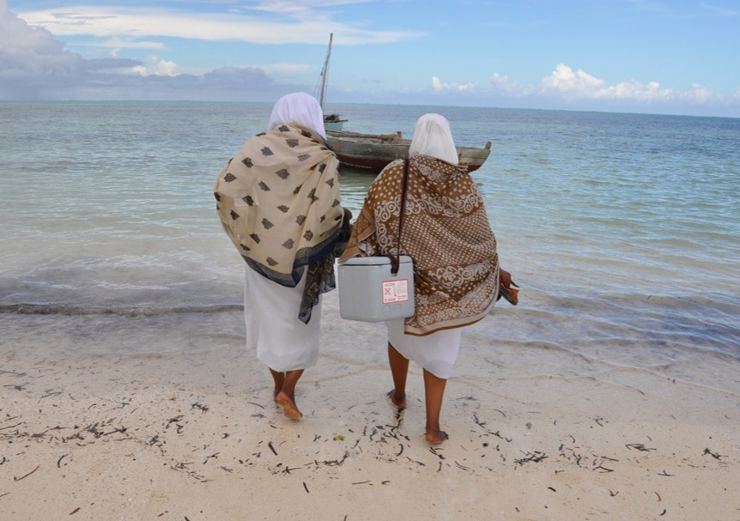
But eHealth isn’t everything
Doctors and health workers
Finance
Governance
Infrastructure
Pharmaceuticals
Vaccines
Medical research
Sanitation

Slide 12
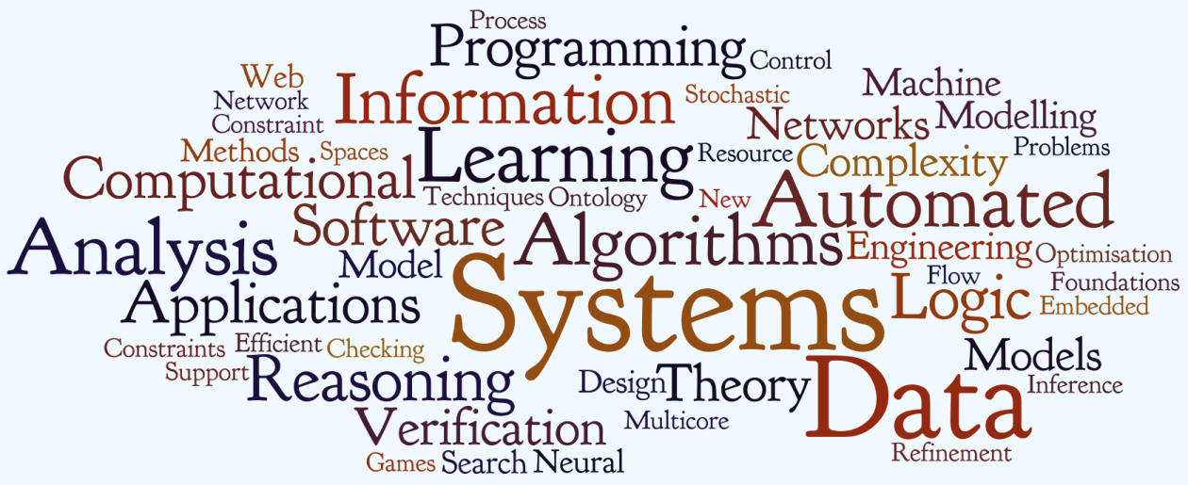

Where is the Computer Science?

Slide 13
Getting the technology correct
Implementation of large scale systems in novel settings
Challenging blend of technologies
Opportunity to implement with current technologies
  People involved with implementation may not utilize current technologies
  People in charge of implementation may not understand current technologies

Slide 14
Problems at scale
Health systems are large
  Impacts everyone
Basis of computer science: what happens when n gets large?
Focus of computer science and the computing industry
  Large scale deployment
  Autonomous deployment
  Robust deployment

Slide 15
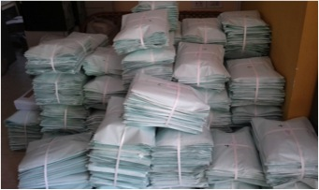
Data
Essentially all ICT applications in global health involve data
Computer science
  Database management
  Data visualization
  Data processing
  Big data

Slide 16
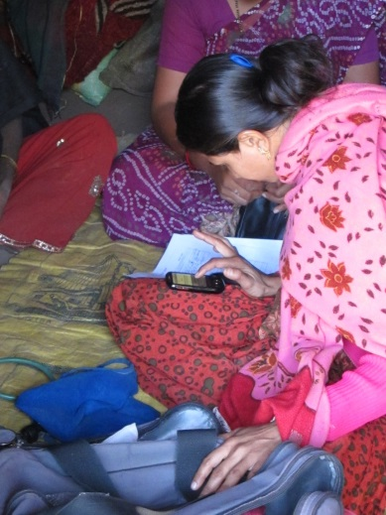
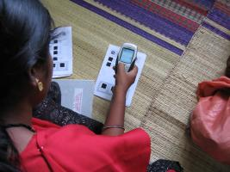
HCI and Usability
Novel applications
New user populations
Technology change

Slide 17
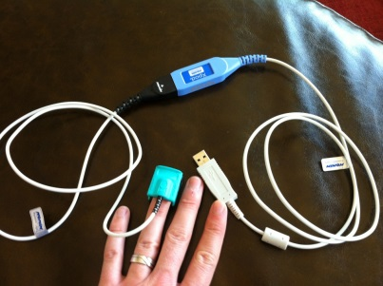
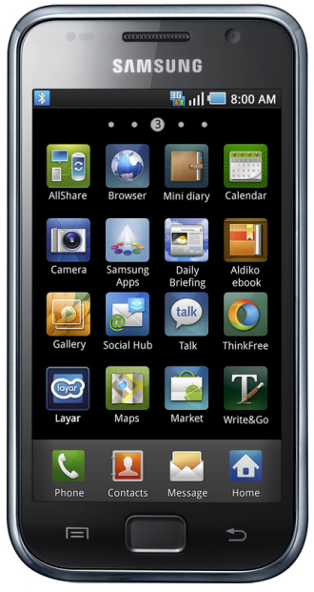
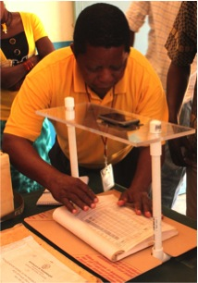
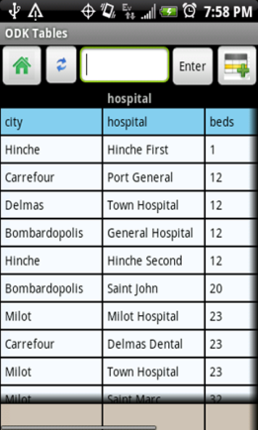
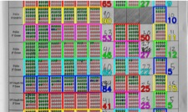
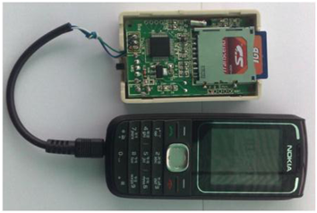
Innovation
Potential for computing ideas to have impact

Slide 18
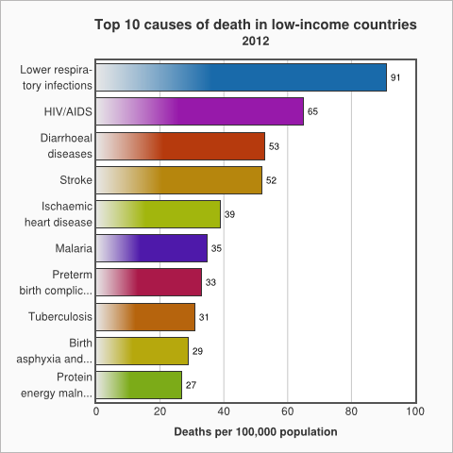
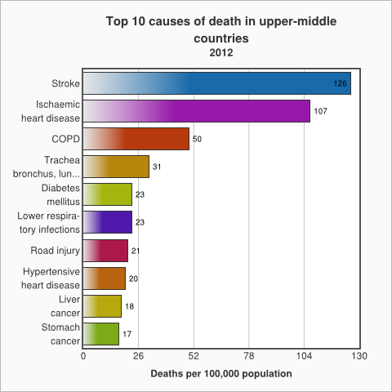
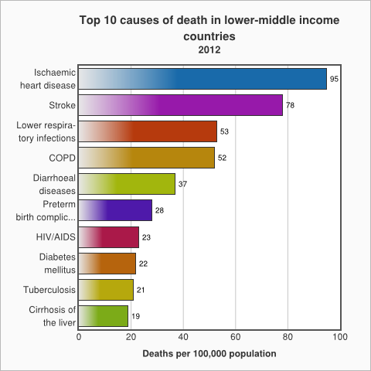
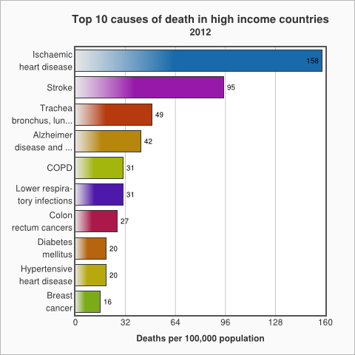
Health domains / Burden of disease
LIC
UMIC
LMIC
HIC
Source: WHO

Slide 19
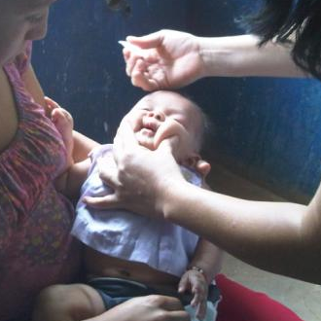
Immunization
Routine immunization: “Most successful public health intervention ever”
  Reach is near universal
Schedule of about 6 to 8 vaccines over first two years
Vaccine logistics: making sure there is enough stock and keeping vaccines cold
Coverage problem: reach the fifth child
Push to introduce new vaccines
Polio is a special case

Slide 20

Major diseases
HIV / TB / Malaria

Slide 21
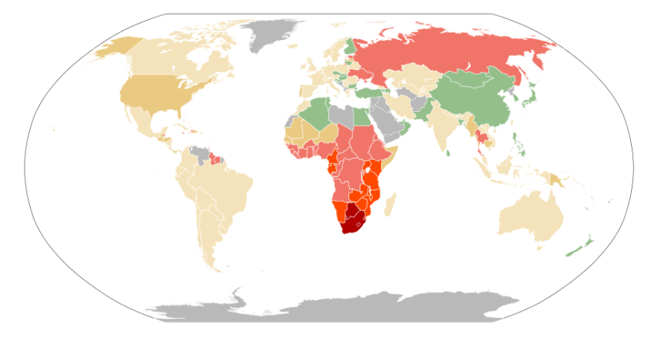
HIV
High rates of infection in Sub Saharan Africa (SSA)
Wide scale introduction of Anti Retroviral Therapy (ART)
Massive resources devoted to HIV
  President’s Emergency Plan for AIDS Relief (PEPFAR)
  Direct support for 4.5 million people on ART
Issues of stigma
  Sex workers, Men who have sex with men, IV Drug users
Case based treatment
Behavior change to reduce transmission
Prevention of mother to child transmission (PMTCT)

Slide 22
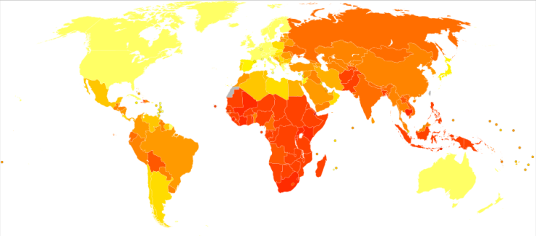
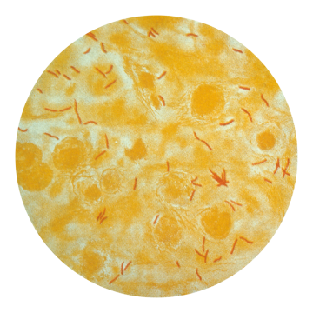
Tuberculosis
Widespread lung disease
  Roughly 1/3rd of population estimated to have latent TB
  Active TB
    Chronic cough, spitting up blood
Treatable with antibiotics
  Rise of Multidrug Resistant (MDR) TB
  Six month treatment regimen, but symptoms disappear earlier
  Directly observed therapy, short-course (DOTS)
Case detection
  View sputum sample under microscope

Slide 23
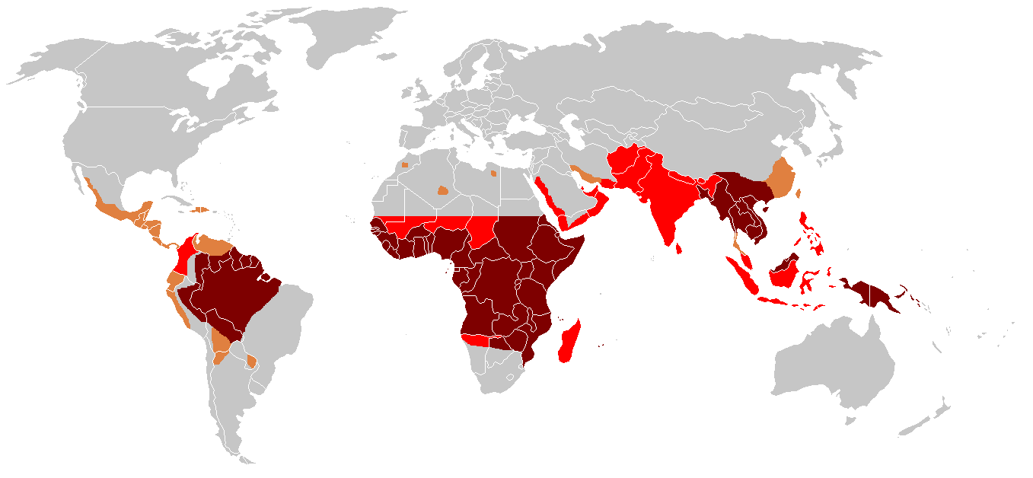
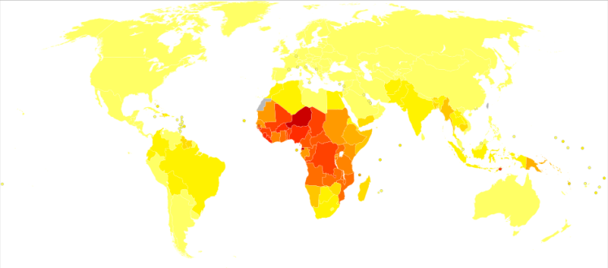
Malaria
Parasitic disease transmitted by mosquitos
  Recurrent fever
  Significant cause of childhood deaths
Treatable with various drugs
  Diagnose and treat vs. Presumptive treatment
Malaria eradication
  Europe and US used to be malarial
  Disrupt cycle at multiple points
    Habitat, mosquito elimination, infection prevention, parasite reservoir
    Track individual cases for elimination
Hope for vaccine

Slide 24
Maternal and child health and nutrition (MCHN)
Maternal Mortality Rate (Deaths per 100,000)
Infant Mortality Rate (Deaths per 1,000 live births)
Causes of maternal death: postpartum hemorrhage, eclampsia, obstructed labor, and sepsis
Causes of infant death: preterm delivery, infection, asphyxia
Interventions
  Improved care, institutional delivery, antenatal care visits, recognition of danger signs, immunization, community health workers
 | MMR (1990) | MMR (2013) | IMR (1990) | IMR (2013)
Ethiopia | 1400 | 420 | 115 | 58
India | 560 | 190 | 76 | 42
Nigeria | 1200 | 560 | 126 | 73
USA | 12 | 28 | 9 | 5

Slide 25
Reproductive health
Access to Family Planning
  Temporary and permanent methods
Challenges
  Awareness, cultural barriers, logistics, finance

Slide 26

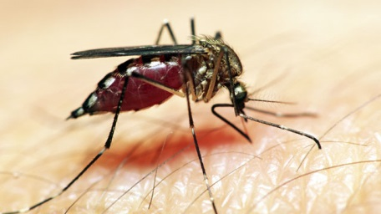
Neglected tropical diseases
Chagas, Human African trypanosomiasis, Leishmaniases, Buruli ulcer, Leprosy, Trachoma, Yaws, Cysticercosis/Taeniasis, Dracunculiasis, Echinococcosis, Foodborne trematodiases, Lymphatic filariasis, Onchocerciasis, Schistosomiasis, Soil-transmitted helminthiasis, Dengue and Chikungunya, Rabies
Limited support for care, research, and eradication
Lack of financial incentives for pharmaceutical companies
Need for surveillance and diagnostics

Slide 27
Infectious diseases
Diarrhea and Pneumonia are the top two causes of childhood deaths
Vaccines are being introduced to prevent some of these deaths
Treatment
  Diarrhea: Oral Rehydration Salts
  Pneumonia: Antibiotics
Emergent infectious diseases
  SARS, Ebola

Slide 28
Chronic diseases
Hypertension, Diabetes, Smoking related illness
  Increasing burden in developing countries
  Limited focus in global health
  Lifestyle interventions and public health

Slide 29
Health systems
Common structure across the world
Majority of health care delivered by the public system (with a private system for the affluent)
Staffing
  Health system: Doctors, Nurses
  Community: Community health workers, ASHAs
  Private: Pharmacists, Shop keepers, Private practice, traditional

Slide 30
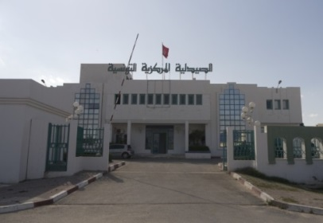
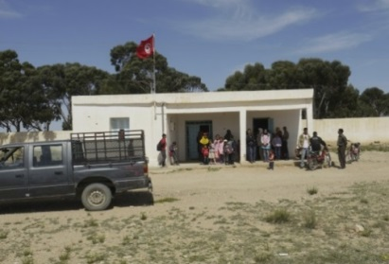
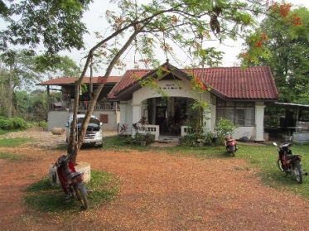
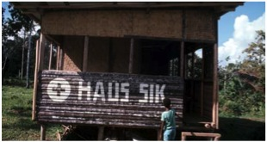
Facility hierarchy
Administrative hierarchy
  Country, Province, District, Subdistrict
Health facility hierarchy
  Province hospital, district hospital, health center, health post
Often similar hierarchies.
Hierarchies important for administration, finance, and reporting

Slide 31
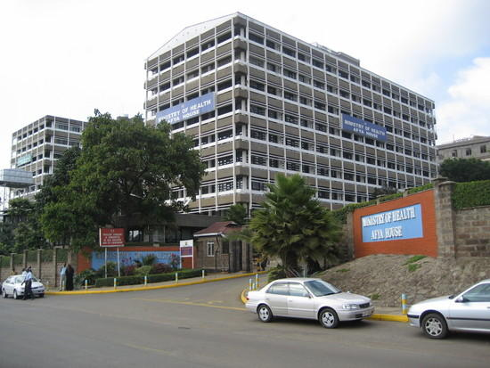
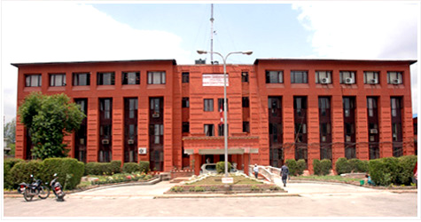
Ministry of Health
Health minister: moderately important cabinet position
Multiple departments inside MoH
  Separate departments for some diseases, immunization, supplies, surveillance
Issues in working across departments
  Collecting data and using data
Potential issues in at different levels of the country
  Powers devolved to provinces or regions

Slide 32
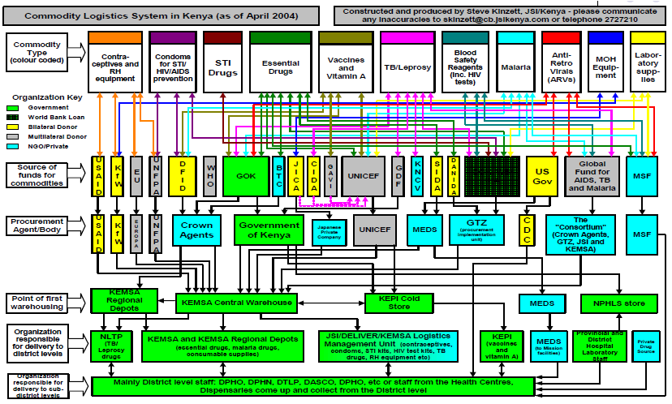
Disease verticals
Different health domains work independently
  Different funding
  Different donor requirements
  Different personal
  Different supply chains
  Different surveillance systems

Slide 33
External Stakeholders
Follow the money . . .

Slide 34



Global
World health organization
UNICEF
GAVI

Slide 35




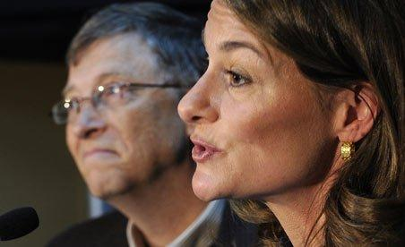

Donors
Bill & Melinda Gates Foundation
USAID
DFID
GDZ
NORAD

Slide 36






Implementing NGOs

Slide 37







Research establishment

Slide 38







Technology NGOs

Slide 39
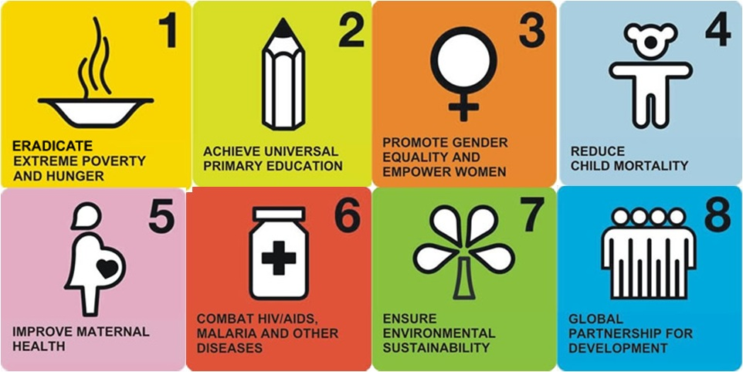
Millennium development goals
International development goals established by United Nations in 2000
Targets results by end of 2015

Slide 40
Millennium development goals
To eradicate extreme poverty and hunger
To achieve universal primary education
To promote gender equality and empower women
To reduce child mortality
To improve maternal health
To combat HIV/AIDS, malaria, and other diseases
To ensure environmental sustainability
To develop a global partnership for development

Slide 41
Targets and Indicators (1-3)
Goal 1: Eradicate extreme poverty and hunger
  Target 1A: Halve, between 1990 and 2015, the proportion of people living on less than $1.25 a day
    Poverty gap ratio [incidence x depth of poverty]
    Share of poorest quintile in national consumption
  Target 1B: Achieve Decent Employment for Women, Men, and Young People
    GDP Growth per Employed Person
    Employment Rate
    Proportion of employed population below $1.25 per day (PPP values)
    Proportion of family-based workers in employed population
  Target 1C: Halve, between 1990 and 2015, the proportion of people who suffer from hunger
    Prevalence of underweight children under five years of age
    Proportion of population below minimum level of dietary energy consumption
Goal 2: Achieve universal primary education
  Target 2A: By 2015, all children can complete a full course of primary schooling, girls and boys
    Enrolment in primary education
    Completion of primary education
Goal 3: Promote gender equality and empower women
  Target 3A: Eliminate gender disparity in primary and secondary education preferably by 2005, and at all levels by 2015
    Ratios of girls to boys in primary, secondary and tertiary education
    Share of women in wage employment in the non-agricultural sector
    Proportion of seats held by women in national parliament

Slide 42
Targets and Indicators (4-5)
Goal 4: Reduce child mortality rates
  Target 4A: Reduce by two-thirds, between 1990 and 2015, the under-five mortality rate
    Under-five mortality rate
    Infant (under 1) mortality rate
    Proportion of 1-year-old children immunized against measles
Goal 5: Improve maternal health
  Target 5A: Reduce by three quarters, between 1990 and 2015, the maternal mortality ratio
    Maternal mortality ratio
    Proportion of births attended by skilled health personnel
  Target 5B: Achieve, by 2015, universal access to reproductive health
    Contraceptive prevalence rate
    Adolescent birth rate
    Antenatal care coverage
    Unmet need for family planning

Slide 43
Targets and Indicators (6)
Goal 6: Combat HIV/AIDS, malaria, and other diseases
  Target 6A: Have halted by 2015 and begun to reverse the spread of HIV/AIDS
    HIV prevalence among population aged 15–24 years
    Condom use at last high-risk sex
    Proportion of population aged 15–24 years with comprehensive correct knowledge of HIV/AIDS
  Target 6B: Achieve, by 2010, universal access to treatment for HIV/AIDS for all those who need it
    Proportion of population with advanced HIV infection with access to antiretroviral drugs
  Target 6C: Have halted by 2015 and begun to reverse the incidence of malaria and other major diseases
    Prevalence and death rates associated with malaria
    Proportion of children under 5 sleeping under insecticide-treated bednets
    Proportion of children under 5 with fever who are treated with appropriate anti-malarial drugs
    Incidence, prevalence and death rates associated with tuberculosis
    Proportion of tuberculosis cases detected and cured under DOTS (Directly Observed Treatment Short Course)

Slide 44
Targets (Goals 7-8)
Goal 7: Ensure environmental sustainability
  Target 7A: Integrate the principles of sustainable development into country policies and programs; reverse loss of environmental resources
  Target 7B: Reduce biodiversity loss, achieving, by 2010, a significant reduction in the rate of loss
  Target 7C: Halve, by 2015, the proportion of the population without sustainable access to safe drinking water and basic sanitation (for more information see the entry on water supply)
  Target 7D: By 2020, to have achieved a significant improvement in the lives of at least 100 million slum-dwellers
Goal 8: Develop a global partnership for development
  Target 8A: Develop further an open, rule-based, predictable, non-discriminatory trading and financial system
  Target 8B: Address the Special Needs of the Least Developed Countries (LDCs)
  Target 8C: Address the special needs of landlocked developing countries and small island developing States
  Target 8D: Deal comprehensively with the debt problems of developing countries through national and international measures in order to make debt sustainable in the long term
  Target 8E: In co-operation with pharmaceutical companies, provide access to affordable, essential drugs in developing countries
  Target 8F: In co-operation with the private sector, make available the benefits of new technologies, especially information and communications
    Telephone lines and cellular subscribers per 100 population
    Personal computers in use per 100 population
    Internet users per 100 Population

Slide 45
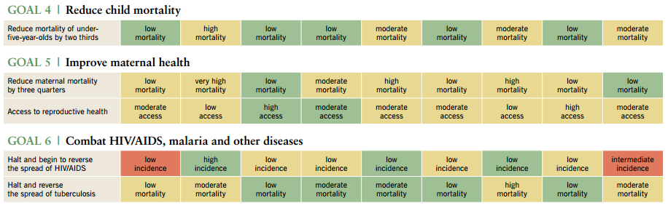
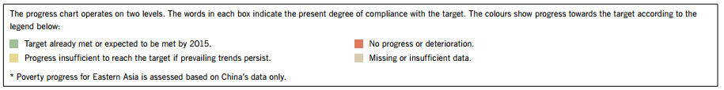
Progress to MDG (2013)
http://www.un.org/millenniumgoals/pdf/report-2013/2013_progress_english.pdf

Slide 46
Health Indicators
Numbers to quantify health outcomes
Standardized to allow a basis of comparison
Challenges and issues
  Often inaccurate or based on very different estimates
  Errors or bias in reporting
  Denominator issues (guessing at the population)
  Achieving good indicators can influence policies

Slide 47
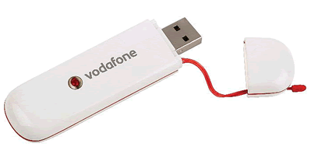
Technologies
Technology is changing very rapidly
In the capital city
  Computers, WIFI, Starbucks, electricity
In the district town
  Network by WIFI Dongle
In the remote health post
  More challenging

Slide 48

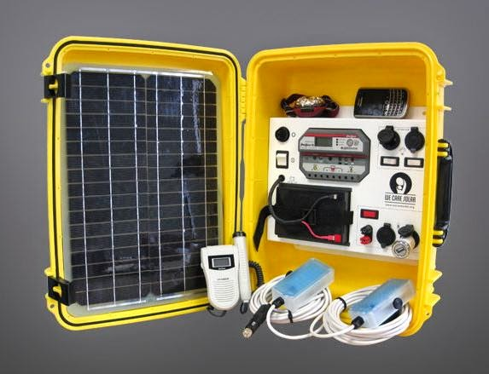
Electrical Infrastructure
Highly variable by country
Major cities often have reliable power
Some areas have frequent cuts due to lack of capacity or fuel (power off 20 hours a day)
Remote areas may be cut off from grid for extended periods of time for repairs
Health facilities often have generators
  But can be expensive to run

Slide 49
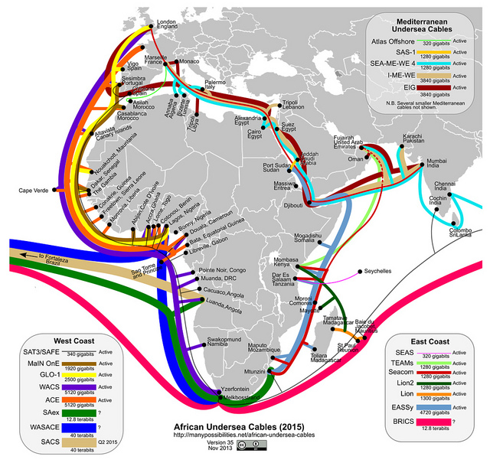
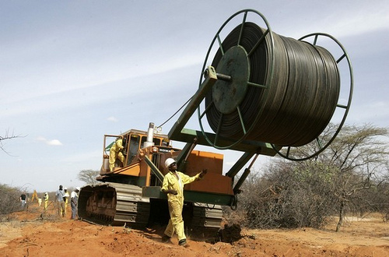
Networking Infrastructure
Dramatic improvement in network bandwidth
  Most countries have substantial international connectivity
Domestic fiber increasing
Connections through mobile network
  High variation in price

Slide 50
Computing Infrastructure
Windows
  Windows 7, Windows 8, Windows XP
  Office
  Substantial improvement in quality of PCs in recent years
Linux and Apple
  Tech NGOs
Server hosting issues

Slide 51
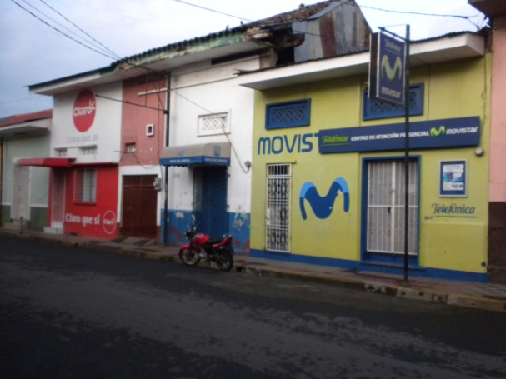
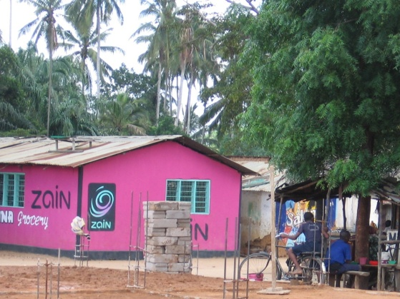
Mobile phone infrastructure
Very high penetration of mobile phones
Most health workers will have access to a mobile phone
However
  Some remote areas will not have access
  Some countries have low competition and consequently high costs
  Paying for calls or charging phones will be an issue in some places

Slide 52

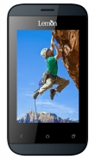
Smart phones and dumb phones
Smart phones and tablets are growing very fast in developing countries
  Low cost Android phones ($50) or proprietary OS touch phones
  Fastest growth in urban areas and amongst the youth
  Social media and multimedia apps
Feature phones are still important for multimedia

Slide 53
Additional issues

Slide 54
Data ownership and privacy
Countries protective of health data
  Proprietary data
  Concerns about loss of control or ‘looking bad’
Where is the data hosted?
How sensitive is health data
  Risks of disclosure
  Practices are common that would not be acceptable/legal in the US
  Where is there an expectation of privacy on data

Slide 55
Research Ethics and IRBs
Very strict ethics requirements have been developed for medical research (in response to horrific abuses)
  Many countries have also established review boards
Principles
  Informed consent
  Free from harm
  Avoid conflicts of interest
Process designed for controlled trials but less clear for other activities
  Is it research?
  Issues on conducting a pilot project that won’t be continued

Slide 56
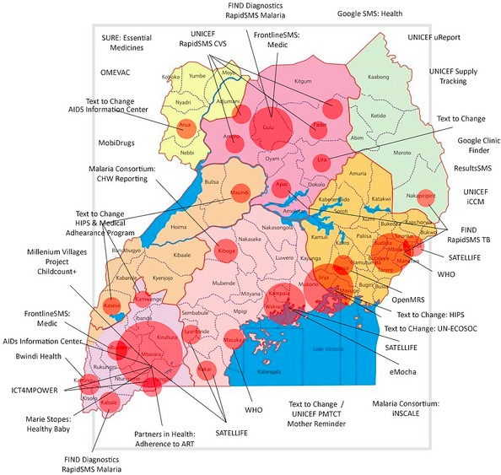
mHealth pilots
Country reaction against small mHealth projects
  Several countries have declared moratoriums. “No more pilots”
Issues
  Lack of results from Pilots
  No sustainability plans
  Incompatibility

Slide 57
Topics

Slide 58


Surveillance
Collect national health statistics
Monthly report of how many children have been vaccinated for measles from every health facility in the country

Slide 59


Patient Tracking
Track people with a specific condition
Maintain a registry of all TB patients in the country with weekly updates on medication taken

Slide 60

Medical records
Clinical records of patients with full history of health treatment and lab tests
Care of HIV patients with access to lab tests

Slide 61


Logistics
Deliver drugs and medical supplies to health facilities
Track the stock levels of vaccines at all health facilities and storage depots to have advanced warning of impending stockouts

Slide 62


Patient support
Assist the patient in receiving appropriate care
SMS information and reminder messages during pregnancy

Slide 63

Treatment support
Tools to assist in the diagnosis or treatment of a condition
Pulse oximeter connected to a mobile device to assist health worker in diagnosing pneumonia

Slide 64



Health worker support
Tools to assist health workers in performing their tasks
Mobile data collection tools to allow community health workers to record information about household visits

Slide 65


Behavior change
Promote or create awareness of practices that will improve health
Mobile phone videos to assist couples in understanding their family planning options

Slide 66


Finance
Providing mechanisms to pay for services
Mobile money for community health worker incentive payments

Slide 67
Next week
Assign 1 Due, Start of class
Topic - Surveillance

